Slide 1
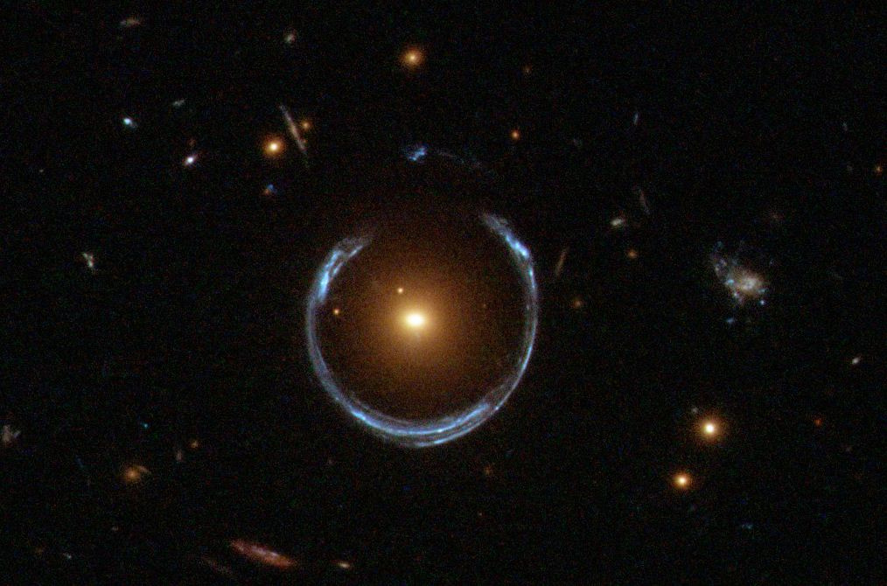
PAGE 01
STRONG GRAVITATIONAL LENSING SUPER-RESOLUTION
KOO HO YIN JACK
SYED MOMIN AHMED RIZVI
CSE & PHYSIC
CSE & MATH

Slide 2
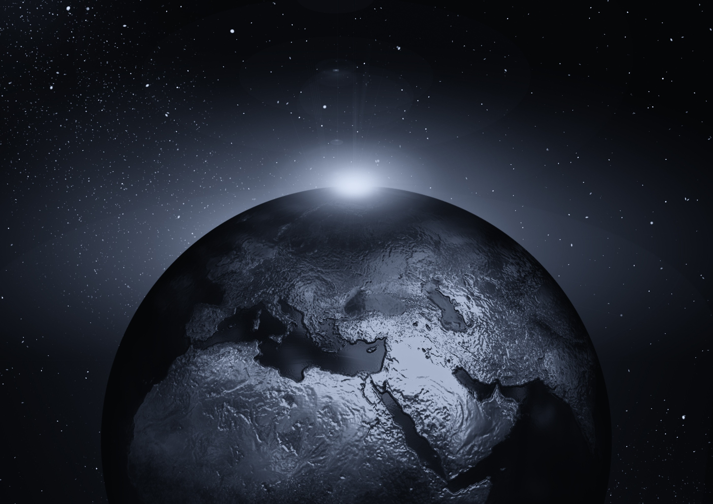
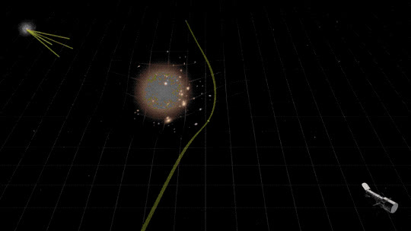
PAGE 02
WHY IS GRAVITATIONAL LENSING INTERESTING?
Gravitational lensing occurs when a massive celestial body is heavy enough to bend the path of light.
However, for some observed lenses, the normal matter there does not have enough gravity to bend spacetime.
This suggests the existence of a new matter, dark matter

Slide 3
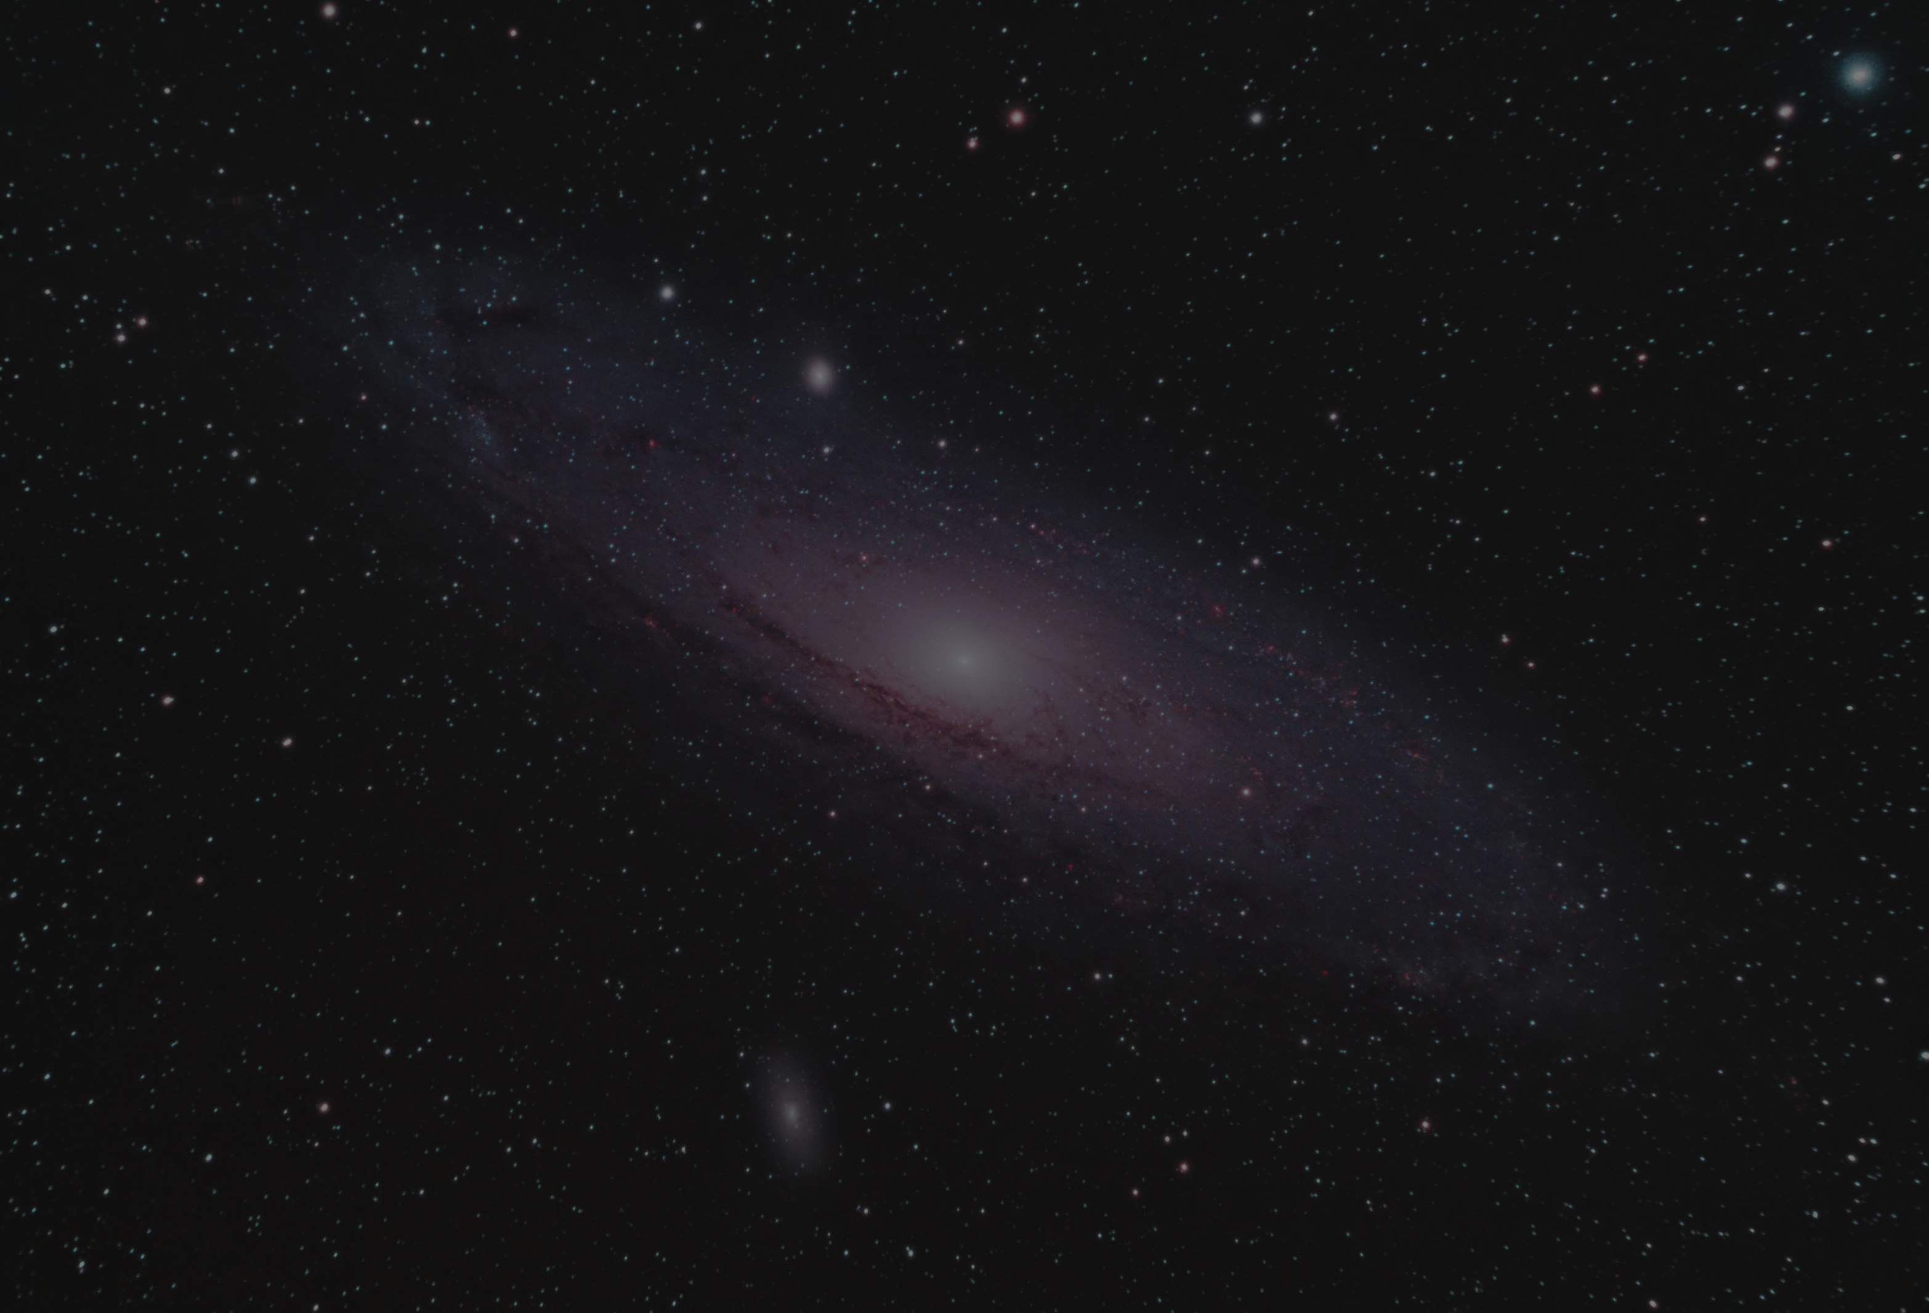
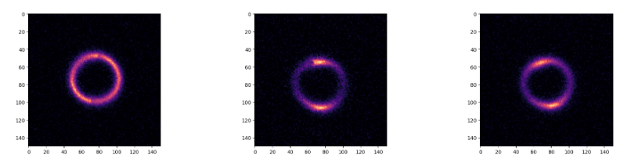
PAGE 03
THE SHAPE OF GL DETERMINES
THE TYPE OF DARK MATTER
NO-SUBSTRUCTURE DARK MATTER
AXION DARK MATTER
COLD DARK MATTER

Slide 4
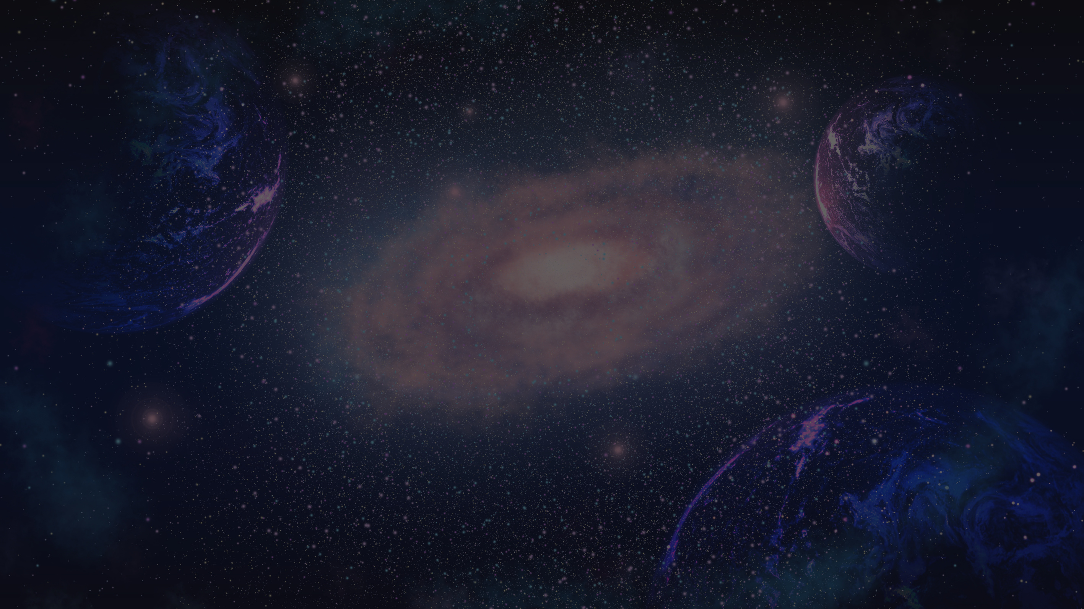

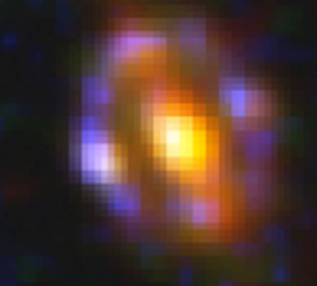
PAGE 04
THERE IS JUST A SMALL PROBLEM,
THE LENS IS TOO BLURRY TO SEE THE SHAPE
SIMULATED IMAGE
OBSERVED IMAGE

Slide 5

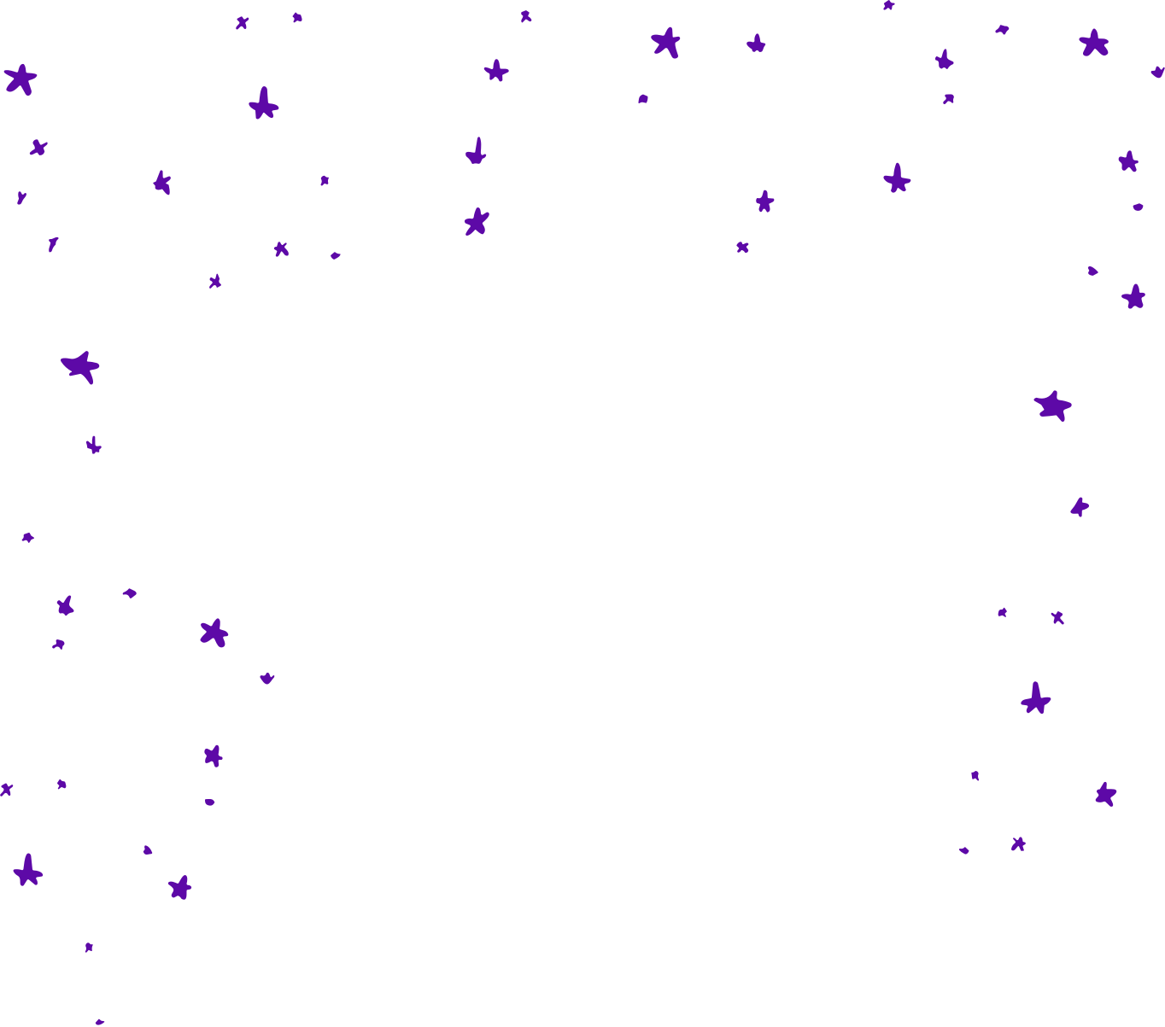
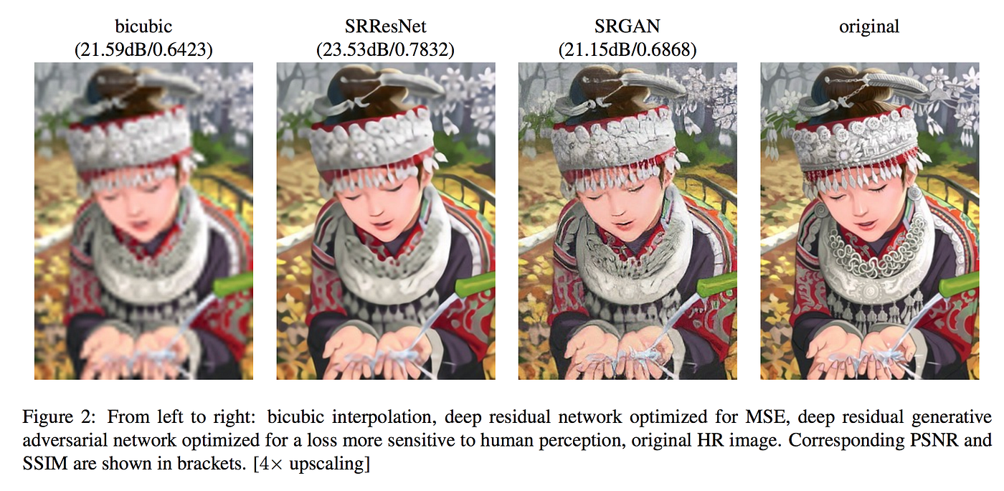


PAGE 05
PAGE 01
THIS IS WHERE DEEP LEARNING IS USEFUL
SUPER-RESOLUTION!!

Slide 6
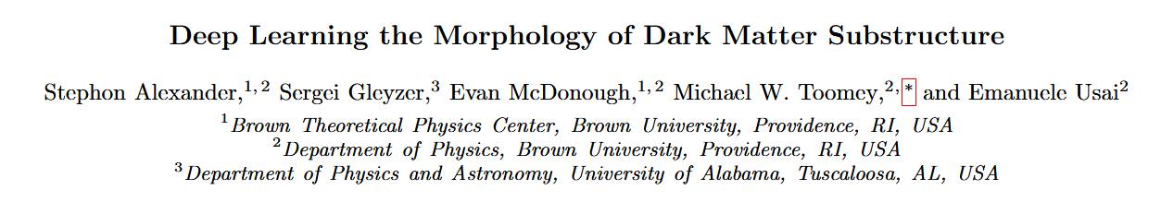
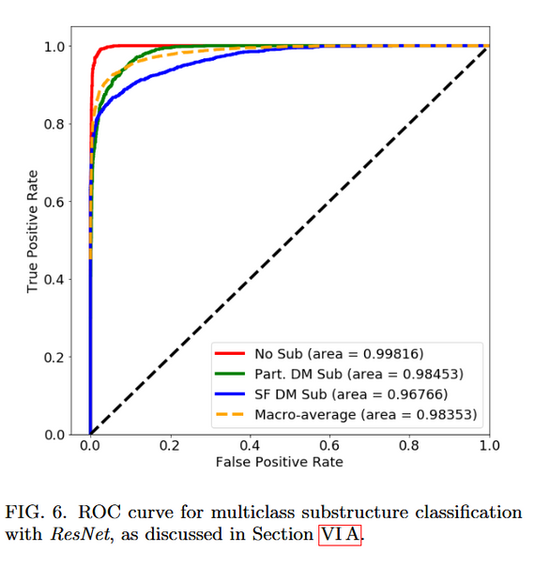
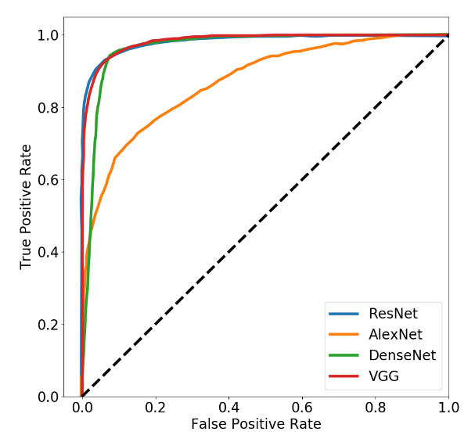
PAGE 06
RELATED WORK
CLASSIFICATION OF SIMULATED GLS WITH DIFFERENT TYPE OF DARK MATTER:

Slide 7
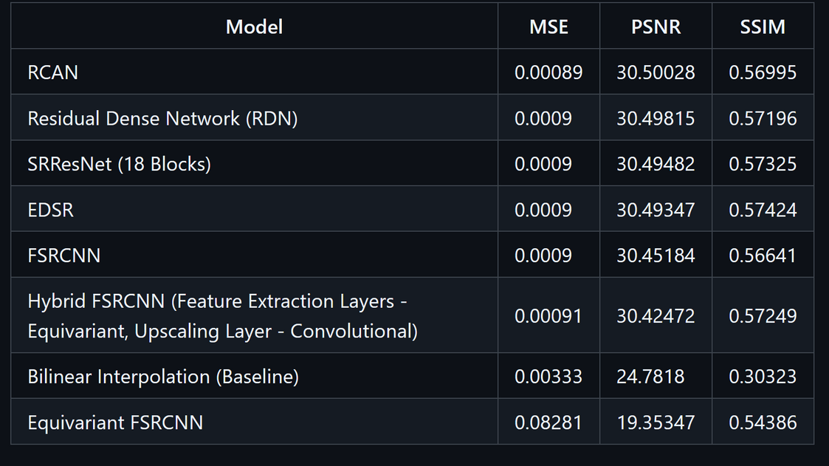
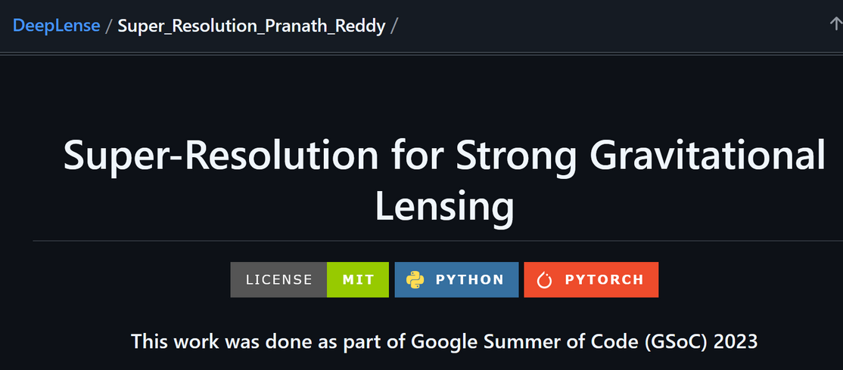
PAGE 07
RELATED WORK
2. NEURAL NETWORK BASED SUPER-RESOLUTION

Slide 8
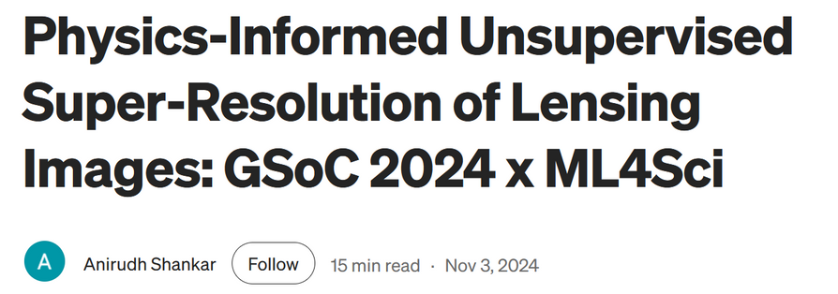

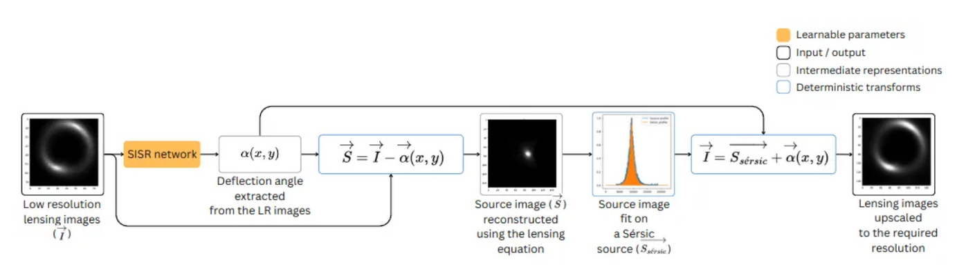
PAGE 08
RELATED WORK
3. PHYSICS-INFORMED NEURAL NETWORK BASED SUPER-RESOLUTION
SERSIC PROFILE

Slide 9
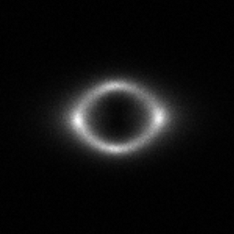
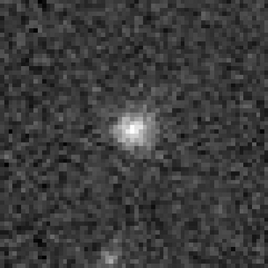
PAGE 09
LIMITATION OF EXISTING METHOD:
THEY ONLY USE SIMULATION DATA
v.s.
REALITY IS ALWAYS MORE DIFFICULT

Slide 10
PAGE 09
QUESTION:
CAN WE USE OBSERVED DATA FOR TRAINING?

Slide 11


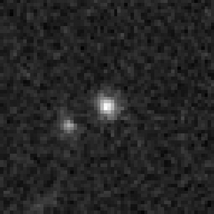
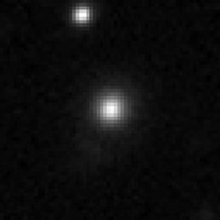
PAGE 11
HERE COMES ANOTHER PROBLEM,
OBSERVED DATA ARE TOO SMALL
300
OBSERVED
HR-LR PAIR
10000
SIMULATED
HR-LR PAIR

Slide 12


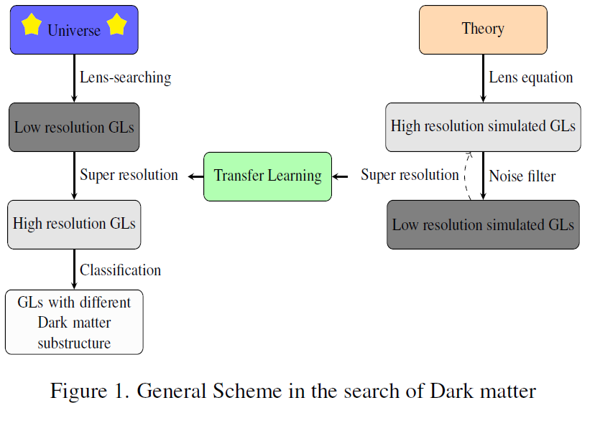


PAGE 12
OUR SOLUTION:
TRANSFER LEARNING

Slide 13

PAGE 13
DATA

Slide 14
PAGE 14
EVALUATION METRIC
MSE: measure average pixel-wise difference
SSIM: measure local variations and textures
PSNR: Peak Signal-to-Noise Ratio

Slide 15
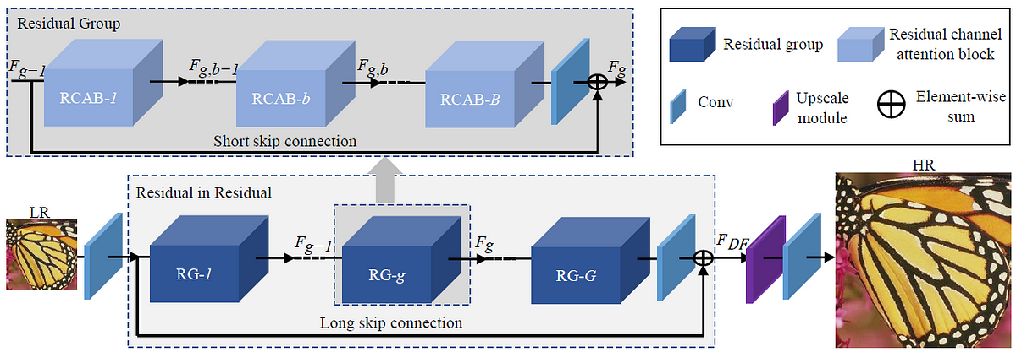
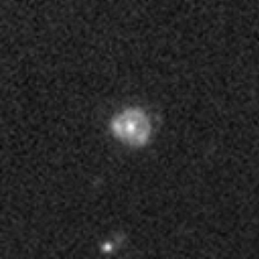
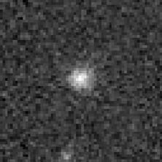
PAGE 15
MODEL USED
RESIDUAL CHANNEL ATTENTION NETWORK(RCAN):

Slide 16
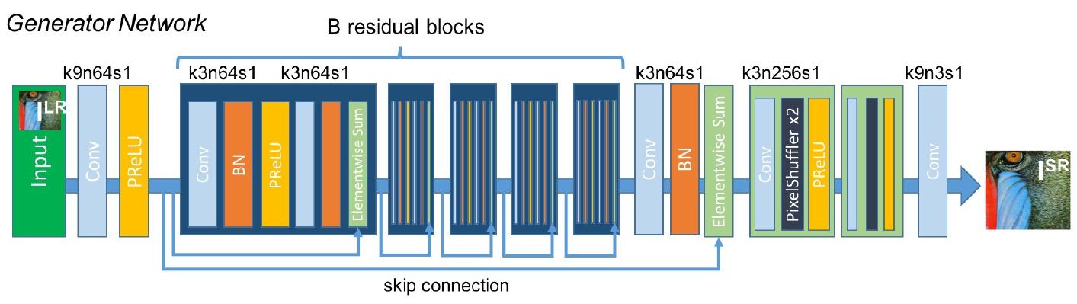
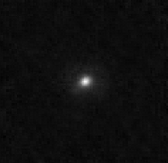
PAGE 16
MODEL USED
2. SUPER-RESOLUTION RESIDUAL NETWORK(SRRESNET):

Slide 17
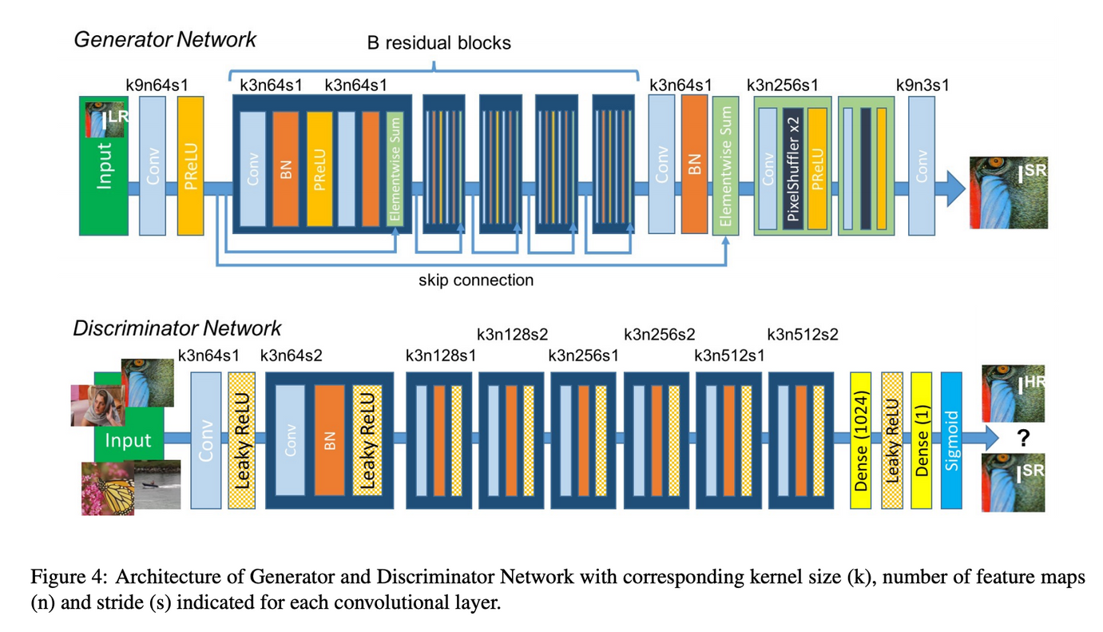
PAGE 17
MODEL USED
2. SUPER-RESOLUTION RESIDUAL NETWORK(SRRESNET):

Slide 18
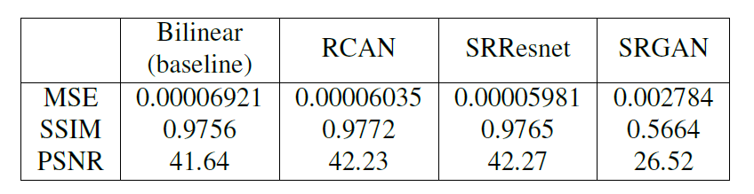
PAGE 18
SIMULATED DATA RESULT

Slide 19
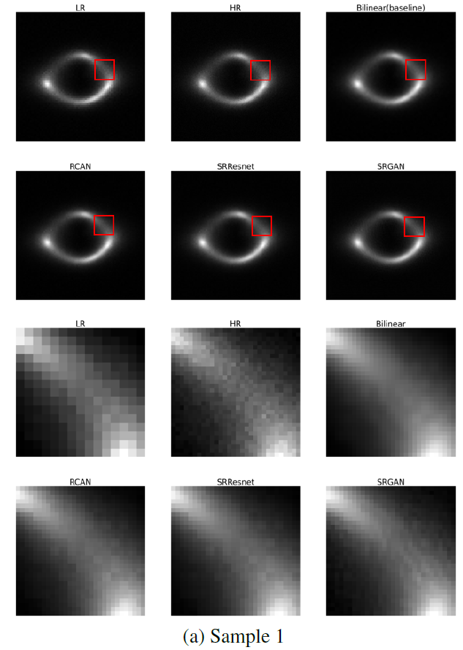
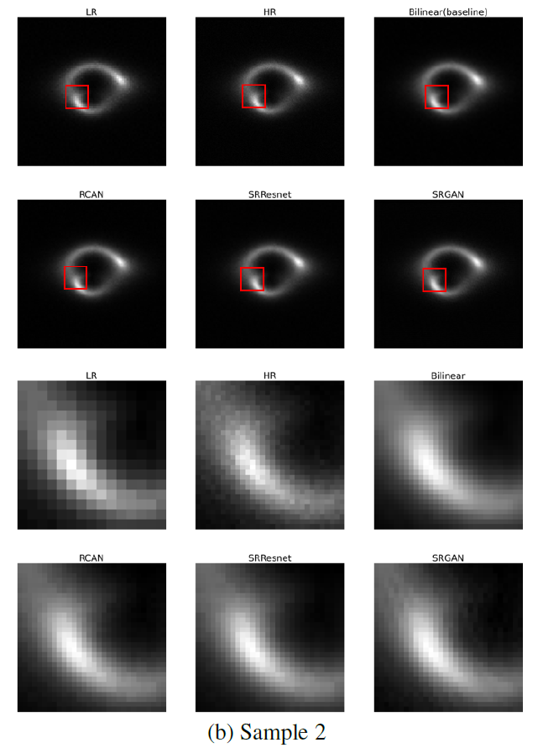
PAGE 19
SIMULATED DATA RESULT

Slide 20
PAGE 20
TRANSFER LEARNING
After obtaing our base model, we can apply our model on real data

Slide 21
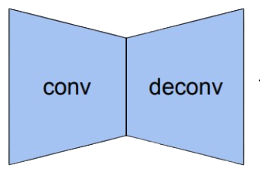
PAGE 21
LAYER FREEZING
Feature extraction
layer
Upsampling
layer
{
{
Freeze
Train

Slide 22
PAGE 22
FINE-TUNING
Unfreeze all layers and use a smaller learning rate to train
{
{
Train
Train

Slide 23
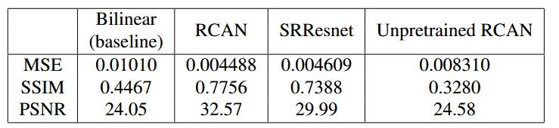
PAGE 23
OBSERVED DATA RESULT

Slide 24
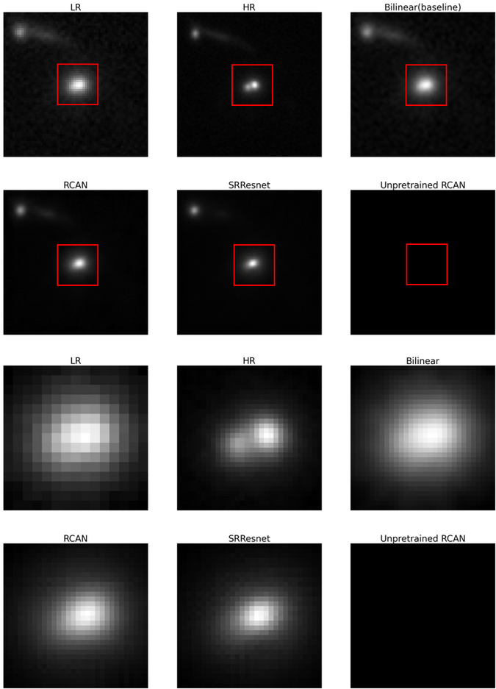
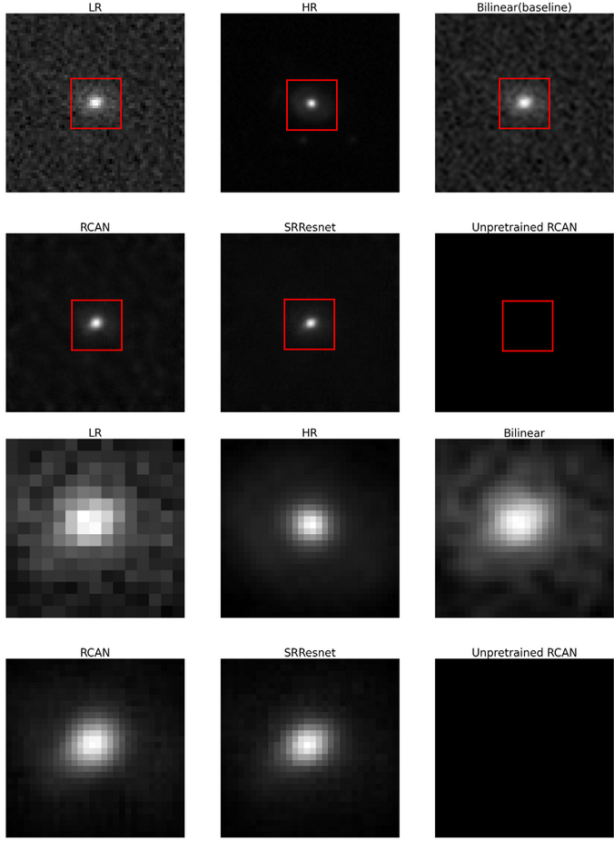
PAGE 24
OBSERVED DATA RESULT

Slide 25
PAGE25
FUTURE WORK
Simulate different types of gravitational lensing.
Check if super-resolution images increase accuracy

Slide 26
PAGE26
REFERENCE
STEPHON ALEXANDER ET AL. DECODING DARK MATTER SUBSTRUCTURE withOUT SUPERVISION. ARXIV PREPRINT, ARXIV:2008.12731, 2020.
ATAL GUPTA. SINGLE IMAGE SUPER-RESOLUTION WITH DIFFUSION MODELS.
NASA. FOCUSING IN ON GRAVITATIONAL LENSES, 2023.
MICHELLE NTAMPAKA ET AL. DEEP LEARNING THE MORPHOLOGY OF DARK MATTER SUBSTRUCTURE. ARXIV PREPRINT, ARXIV:1909.07346, 2019.
J. PRESKILL, M. B. WISE, AND F. WILCZEK. COSMOLOGY OF THE INVISIBLE AXION. PHYSICS LETTERS B, 120(1-3):127–132, 1983.
PRANATH REDDY. SUPER-RESOLUTION FOR STRONG GRAVITATIONAL LENSNG.
ANIRUDH SHANKAR. PHYSICS-INFORMED UNSUPERVISED SUPER-RESOLUTION OF LENSING IMAGES: GSOC 2024 X ML4SCI. MEDIUM,2024.
G. STEIGMAN AND M. S. TURNER. COSMOLOGICAL CONSTRAINTS ON THE PROPERTIES OF WEAKLY INTERACTING MASSIVE PARTICLES. NUCLEAR PHYSICS B, 253:375–386, 1985.
YULUN ZHANG, KUNPENG LI, KAI LI, LICHEN WANG, BINENG ZHONG, AND YUN FU. IMAGE SUPER-RESOLUTION USING VERY DEEP RESIDUAL CHANNEL ATTENTION NETWORKS. ARXIV PREPRINT, ARXIV:1807.02758, 2018. PUBLISHED IN ECCV 2018.

Slide 27
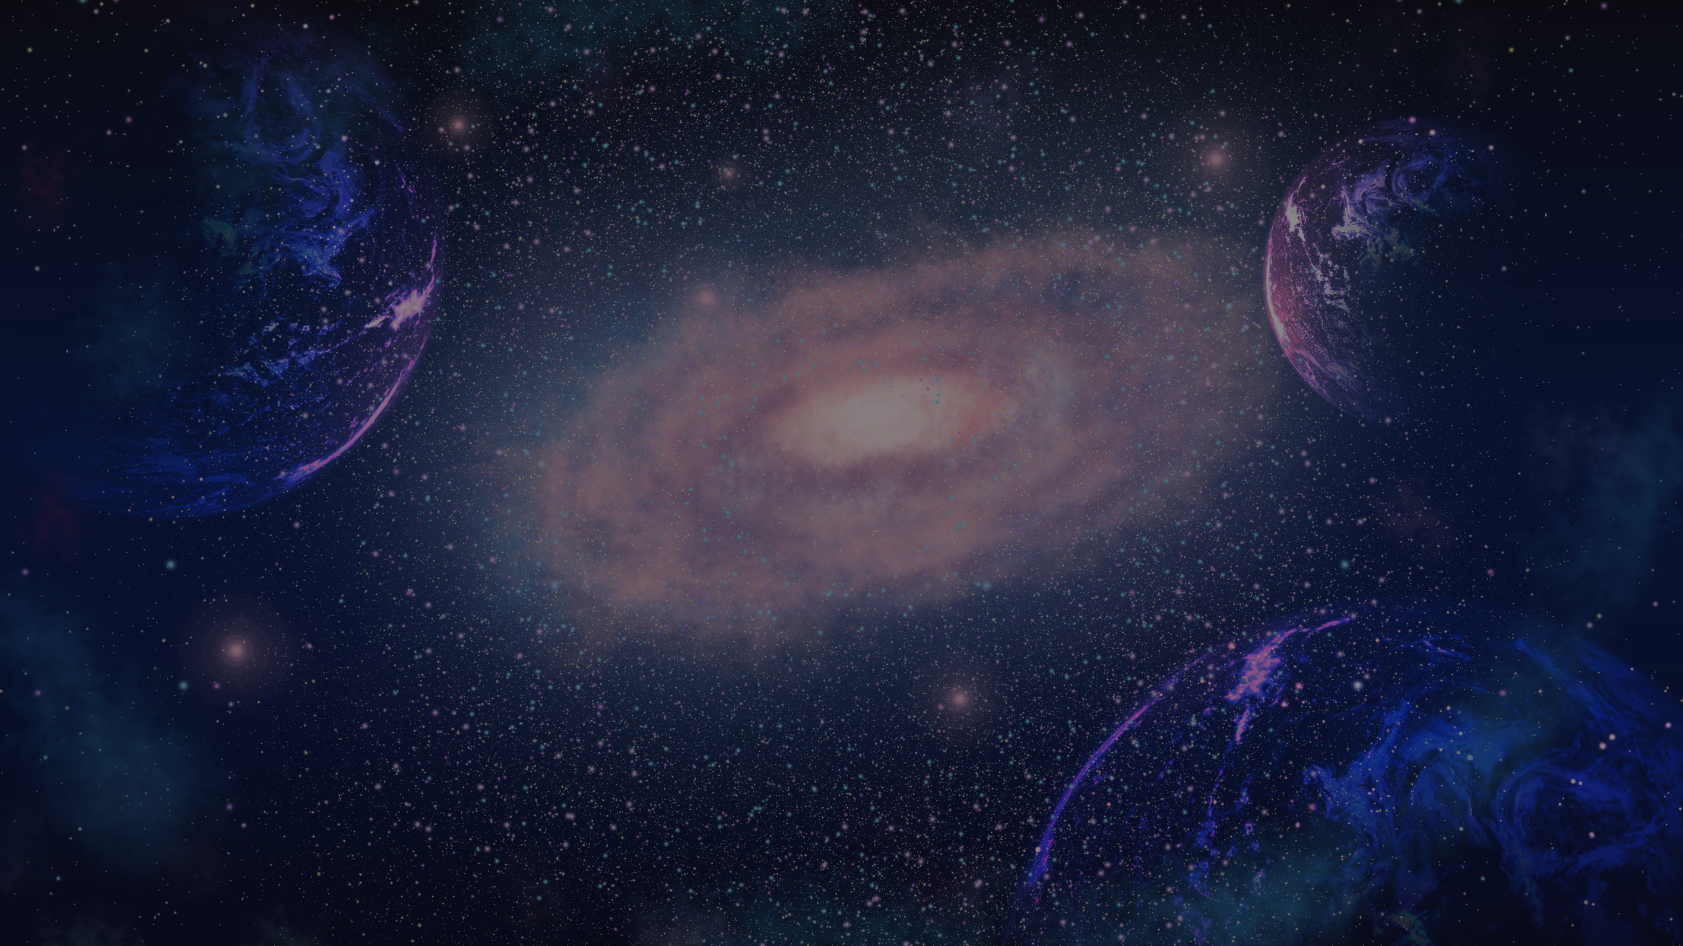
THANK
YOU

